Slide 1
Dependency Injection, Inversion Of Control, Services

Slide 2
Table of Contents
Inversion of Control
Dependency Inversion Principle
Dependency Injection
ASP.NET Core - Project Structure
ASP.NET Core - Dependency Injection
ASP.NET Core – Middleware
ASP.NET Core - Environment Variable
ASP.NET Core - Exception Handling
ASP.NET Core – Static files
Logging in ASP.NET Core

Slide 3
Inversion of Control

Slide 4
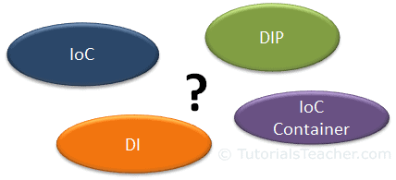
Inversion of Control
The terms Inversion of Control (IoC), Dependency Inversion Principle (DIP), Dependency Injection (DI), and IoC containers may be familiar. But are you clear about what each term means?

Slide 5
Design Principle
Design principles provide high level guidelines to design better software applications.
They do not provide implementation guidelines and are not bound to any programming language.
The SOLID (SRP, OCP, LSP, ISP, DIP) principles are one of the most popular sets of design principles.
For example, the Single Responsibility Principle (SRP) suggests that a class should have only one reason to change.
This is a high-level statement which we can keep in mind while designing or creating classes for our application.
SRP does not provide specific implementation steps but it's up to you how you implement SRP in your application.

Slide 6
Design Pattern
Design Pattern provides low-level solutions related to implementation, of commonly occurring object-oriented problems.
In other words, design pattern suggests a specific implementation for the specific object-oriented programming problem.
For example, if you want to create a class that can only have one object at a time, then you can use the Singleton design pattern which suggests the best way to create a class that can only have one object.
Design patterns are tested by others and are safe to follow, e.g. Gang of Four patterns: Abstract Factory, Factory, Singleton, Command, etc.

Slide 7
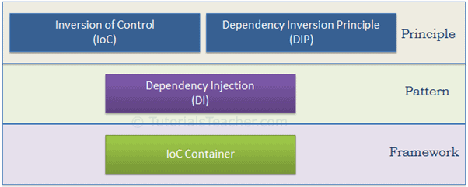
Principles or Patterns
As illustrated in the above figure, IoC and DIP are high level design principles which should be used while designing application classes. As they are principles, they recommend certain best practices but do not provide any specific implementation details. Dependency Injection (DI) is a pattern and IoC container is a framework.

Slide 8
Inversion of Control
IoC is a design principle which recommends the inversion of different kinds of controls in object-oriented design to achieve loose coupling between application classes.
In this case, control refers to any additional responsibilities a class has, other than its main responsibility, such as control over the flow of an application, or control over the dependent object creation and binding (Remember SRP - Single Responsibility Principle).
If you want to do TDD (Test Driven Development), then you must use the IoC principle, without which TDD is not possible.

Slide 9
Dependency Inversion Principle
The DIP principle also helps in achieving loose coupling between classes. It is highly recommended to use DIP and IoC together in order to achieve loose coupling.
DIP suggests that high-level modules should not depend on low level modules. Both should depend on abstraction.
The DIP principle was invented by Robert Martin (a.k.a. Uncle Bob). He is a founder of the SOLID principles.
Dependency Injection (DI)
is a design pattern which implements the IoC principle to invert the creation of dependent objects.

Slide 10
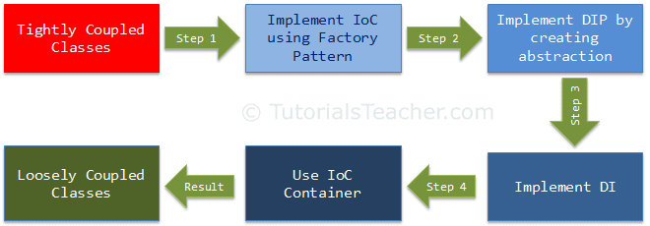
IoC Container
The IoC container is a framework used to manage automatic dependency injection throughout the application, so that we as programmers do not need to put more time and effort into it.
There are various IoC Containers for .NET, such as Unity, Ninject, StructureMap, Autofac, etc.
We cannot achieve loosely coupled classes by using IoC alone. Along with IoC, we also need to use DIP, DI and IoC container. The following figure illustrates how we are going to achieve loosely coupled design step by step.

Slide 11
Inversion of Control
Inversion of Control (IoC) is a design principle (although, some people refer to it as a pattern). As the name suggests, it is used to invert different kinds of controls in object-oriented design to achieve loose coupling. Here, controls refer to any additional responsibilities a class has, other than its main responsibility. This include control over the flow of an application, and control over the flow of an object creation or dependent object creation and binding.
IoC is all about inverting the control. To explain this in layman's terms, suppose you drive a car to your work place. This means you control the car. The IoC principle suggests to invert the control, meaning that instead of driving the car yourself, you hire a cab, where another person will drive the car. Thus, this is called inversion of the control - from you to the cab driver. You don't have to drive a car yourself and you can let the driver do the driving so that you can focus on your main work.
The IoC principle helps in designing loosely coupled classes which make them testable, maintainable and extensible.

Slide 12
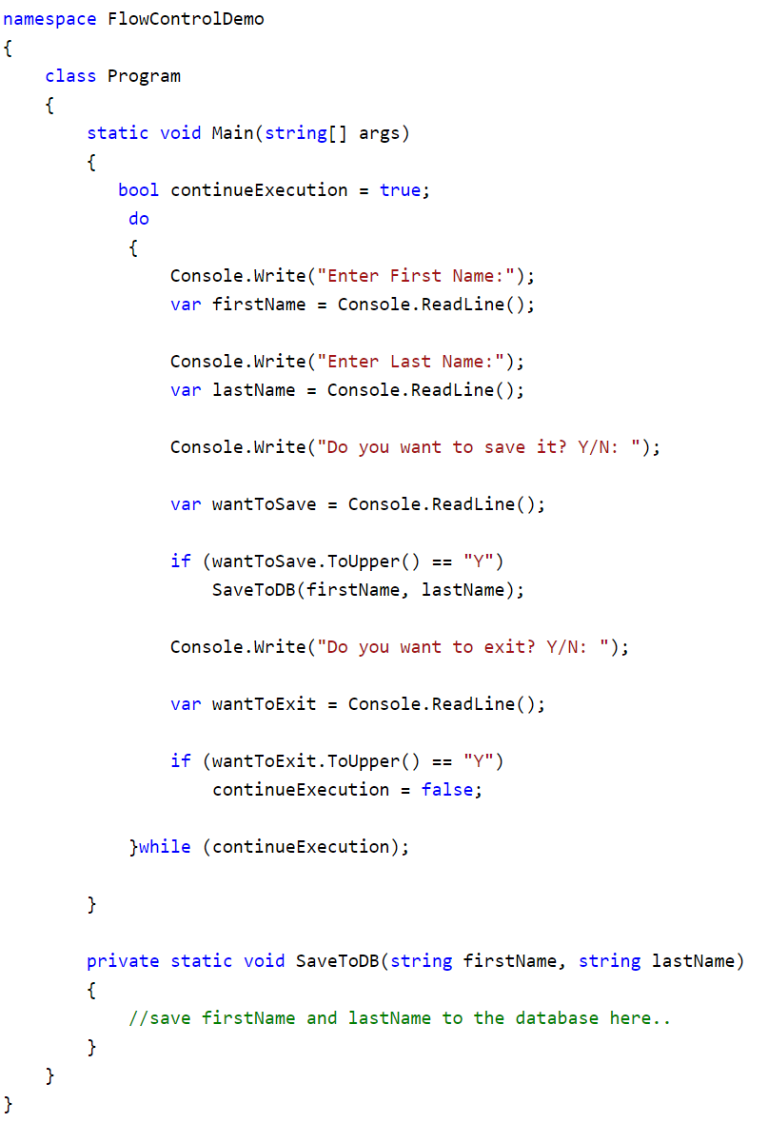
Control Over the Flow of a Program
In a typical console application in C#, execution starts from the Main() function. The Main() function controls the flow of a program or, in other words, the sequence of user interaction. Consider the following simple console program.
In the example, the Main() function of the program class controls the flow of a program. It takes the user's input for the first name and last name. It saves the data, and continues or exits the console, depending upon the user's input. So here, the flow is controlled through the Main() function.

Slide 13
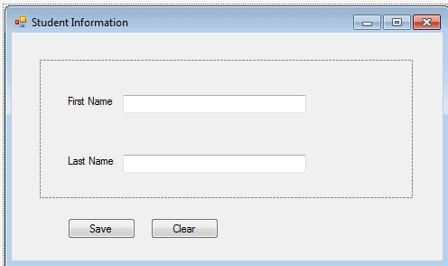
Control Over the Flow of a Program
IoC can be applied to the above program by creating a GUI-based application such as the following windows-based application, wherein the framework will handle the flow of a program by using events.
This is a simple example of implementing IoC in the flow of a program.

Slide 14
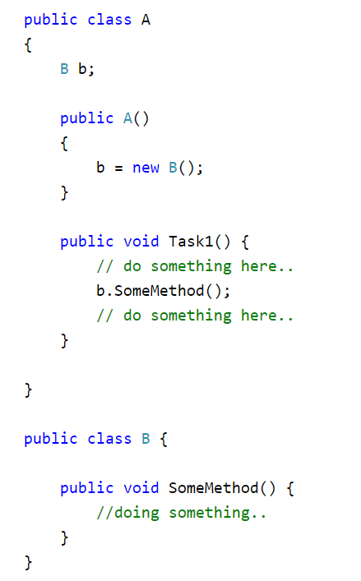
Control Over the Dependent Object Creation
IoC can also be applied when we create objects of a dependent class. First of all, let's understand what we mean by dependency here.
Consider the following example.
In the above example, class A calls b.SomeMethod() to complete its task1. Class A cannot complete its task without class B and so you can say that "Class A is dependent on class B" or "class B is a dependency of class A".
In the object-oriented design approach, classes need to interact with each other in order to complete one or more functionalities of an application, such as in the above example - classes A and B. Class A creates and manages the life time of an object of class B. Essentially, it controls the creation and life time of objects of the dependency class.

Slide 15
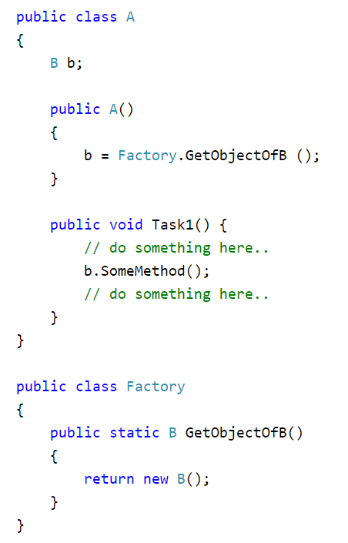
Control Over the Dependent Object Creation
The IoC principle suggests to invert the control. This means to delegate the control to another class. In other words, invert the dependency creation control from class A to another class.
As you can see above, class A uses Factory class to get an object of class B.
Thus, we have inverted the dependent object creation from class A to Factory.
Class A no longer creates an object of class B, instead it uses the factory class to get the object of class B.

Slide 16

Loosely coupled way
In an object-oriented design, classes should be designed in a loosely coupled way. Loosely coupled means changes in one class should not force other classes to change, so the whole application can become maintainable and extensible. Let's understand this by using typical n-tier architecture as depicted by the following figure:
In the typical n-tier architecture, the User Interface (UI) uses Service layer to retrieve or save data. The Service layer uses the BusinessLogic class to apply business rules on the data. The BusinessLogic class depends on the DataAccess class which retrieves or saves the data to the underlying database. This is simple n-tier architecture design. Let's focus on the BusinessLogic and DataAccess classes to understand IoC.

Slide 17
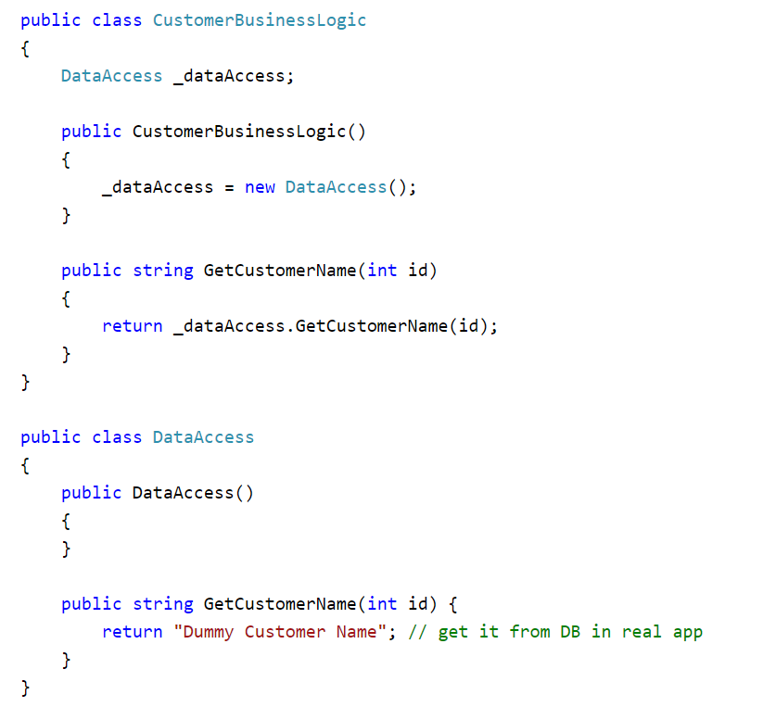
Tightly coupled classes
As you can see in the example, the CustomerBusinessLogic class depends on the DataAccess class. It creates an object of the DataAccess class to get the customer data.
In that example, CustomerBusinessLogic and DataAccess are tightly coupled classes because the CustomerBusinessLogic class includes the reference of the concrete DataAccess class. It also creates an object of DataAccess class and manages the lifetime of the object.

Slide 18
Problems with tightly coupled classes classes
CustomerBusinessLogic and DataAccess classes are tightly coupled classes. So, changes in the DataAccess class will lead to changes in the CustomerBusinessLogic class. For example, if we add, remove or rename any method in the DataAccess class then we need to change the CustomerBusinessLogic class accordingly.
Suppose the customer data comes from different databases or web services and, in the future, we may need to create different classes, so this will lead to changes in the CustomerBusinessLogic class.
The CustomerBusinessLogic class creates an object of the DataAccess class using the new keyword. There may be multiple classes which use the DataAccess class and create its objects. So, if you change the name of the class, then you need to find all the places in your source code where you created objects of DataAccess and make the changes throughout the code. This is repetitive code for creating objects of the same class and maintaining their dependencies.
Because the CustomerBusinessLogic class creates an object of the concrete DataAccess class, it cannot be tested independently (TDD). The DataAccess class cannot be replaced with a mock class.
To solve all of the above problems and get a loosely coupled design, we can use the IoC and DIP principles together. Remember, IoC is a principle, not a pattern. It just gives high-level design guidelines but does not give implementation details. You are free to implement the IoC principle the way you want.

Slide 19
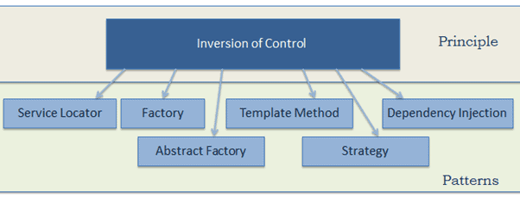
IoC patterns
The following patterns (but not limited) implements the IoC principle.

Slide 20
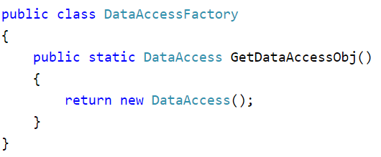
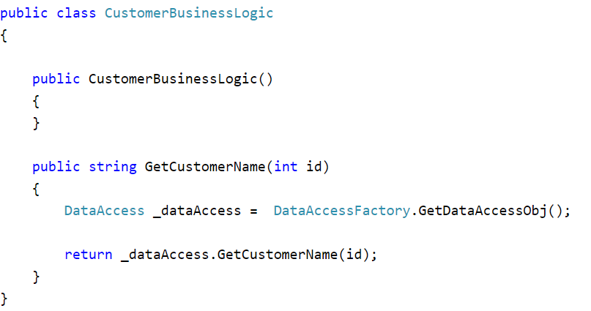
Factory pattern
Now the CustomerBusinessLogic class uses the DataAccessFactory.GetCustomerDataAccessObj() method to get an object of the DataAccess class instead of creating it using the new keyword. Thus, we have inverted the control of creating an object of a dependent class from the CustomerBusinessLogic class to the DataAccessFactory class.
This is a simple implementation of IoC and the first step towards achieving fully loose coupled design. As mentioned earlier, we will not achieve complete loosely coupled classes by only using IoC. Along with IoC, we also need to use DIP, Strategy pattern, and DI (Dependency Injection).

Slide 21
Dependency Inversion Principle
DIP Definition
High-level modules should not depend on low-level modules. Both should depend on the abstraction.
Abstractions should not depend on details. Details should depend on abstractions.

Slide 22
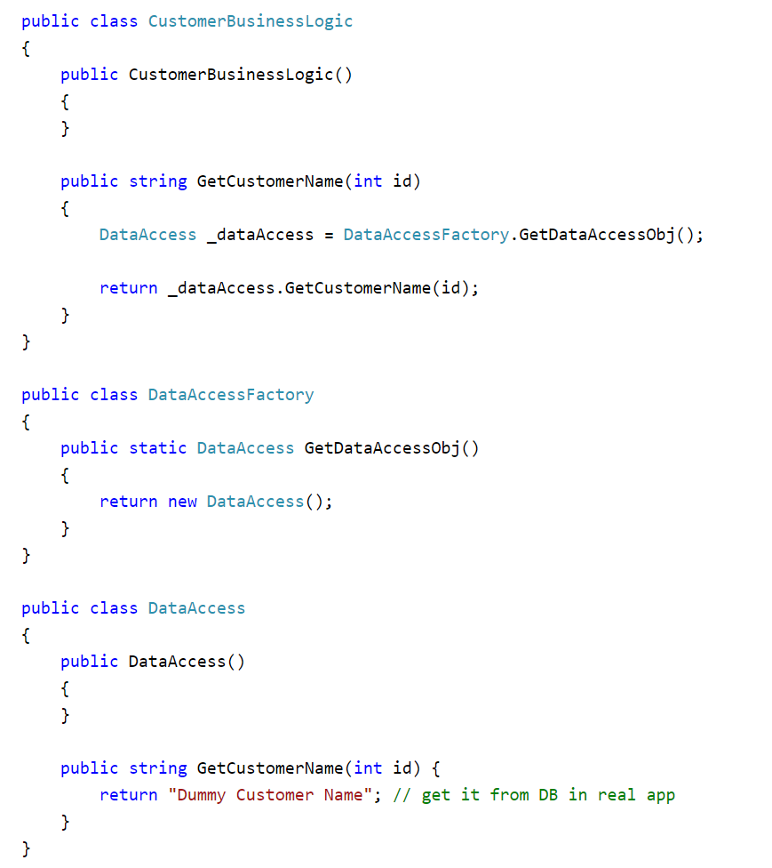
Dependency Inversion Principle
In the above example, we implemented the factory pattern to achieve IoC. But, the CustomerBusinessLogic class uses the concrete DataAccess class. Therefore, it is still tightly coupled, even though we have inverted the dependent object creation to the factory class.
Let's use DIP on the CustomerBusinessLogic and DataAccess classes and make them more loosely coupled.
As per the DIP definition, a high-level module should not depend on low-level modules. Both should depend on abstraction. So, first, decide which is the high-level module (class) and the low-level module. A high-level module is a module which depends on other modules. In our example, CustomerBusinessLogic depends on the DataAccess class, so CustomerBusinessLogic is a high-level module and DataAccess is a low-level module. So, as per the first rule of DIP, CustomerBusinessLogic should not depend on the concrete DataAccess class, instead both classes should depend on abstraction.
The second rule in DIP is "Abstractions should not depend on details. Details should depend on abstractions".

Slide 23
What is an Abstraction?
Abstraction and encapsulation are important principles of object-oriented programming. There are many different definitions from different people, but let's understand abstraction using the above example.
In English, abstraction means something which is non-concrete.
In programming terms, the above CustomerBusinessLogic and DataAccess are concrete classes, meaning we can create objects of them.
So, abstraction in programming means to create an interface or an abstract class which is non-concrete.
This means we cannot create an object of an interface or an abstract class.
As per DIP, CustomerBusinessLogic (high-level module) should not depend on the concrete DataAccess class (low-level module). Both classes should depend on abstractions, meaning both classes should depend on an interface or an abstract class.

Slide 24
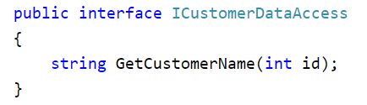
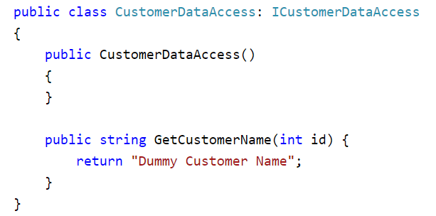
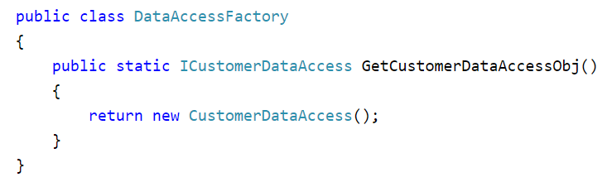
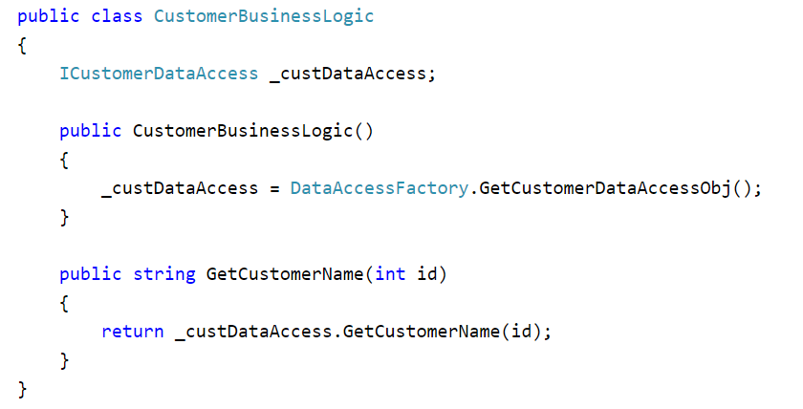
Using Interfaces
Declare the GetCustomerName(int id) method in the interface
Implement ICustomerDataAccess in the CustomerDataAccess class
Change factory class which returns ICustomerDataAccess instead of the concrete DataAccess class
Change the CustomerBusinessLogic class which uses ICustomerDataAccess instead of the concrete DataAccess

Slide 25
Dependency Inversion Principle
So, we have implemented DIP in our example where a high-level module (CustomerBusinessLogic) and low-level module (CustomerDataAccess) are dependent on an abstraction (ICustomerDataAccess).
Also, the abstraction (ICustomerDataAccess) does not depend on details (CustomerDataAccess), but the details depend on the abstraction.
The advantages of implementing DIP in the above example is that the CustomerBusinessLogic and CustomerDataAccess classes are loosely coupled classes because CustomerBusinessLogic does not depend on the concrete DataAccess class, instead it includes a reference of the ICustomerDataAccess interface. So now, we can easily use another class which implements ICustomerDataAccess with a different implementation.
Still, we have not achieved fully loosely coupled classes because the CustomerBusinessLogic class includes a factory class to get the reference of ICustomerDataAccess. This is where the Dependency Injection pattern helps us.

Slide 26
Dependency Injection

Slide 27
Dependency Injection
Dependency Injection (DI) is a design pattern used to implement IoC. It allows the creation of dependent objects outside of a class and provides those objects to a class through different ways. Using DI, we move the creation and binding of the dependent objects outside of the class that depends on them.
The Dependency Injection pattern involves 3 types of classes.
Client Class: The client class (dependent class) is a class which depends on the service class
Service Class: The service class (dependency) is a class that provides service to the client class.
Injector Class: The injector class injects the service class object into the client class.

Slide 28
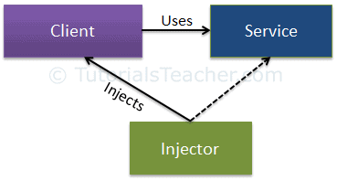
Dependency Injection
The following figure illustrates the relationship between these classes:
The injector class creates an object of the service class, and injects that object to a client object. In this way, the DI pattern separates the responsibility of creating an object of the service class out of the client class.

Slide 29
Types of Dependency Injection
The injector class injects the service (dependency) to the client (dependent). The injector class injects dependencies broadly in three ways: through a constructor, through a property, or through a method.
Constructor Injection: In the constructor injection, the injector supplies the service (dependency) through the client class constructor.
Property Injection: In the property injection (aka the Setter Injection), the injector supplies the dependency through a public property of the client class.
Method Injection: In this type of injection, the client class implements an interface which declares the method(s) to supply the dependency and the injector uses this interface to supply the dependency to the client class.

Slide 30
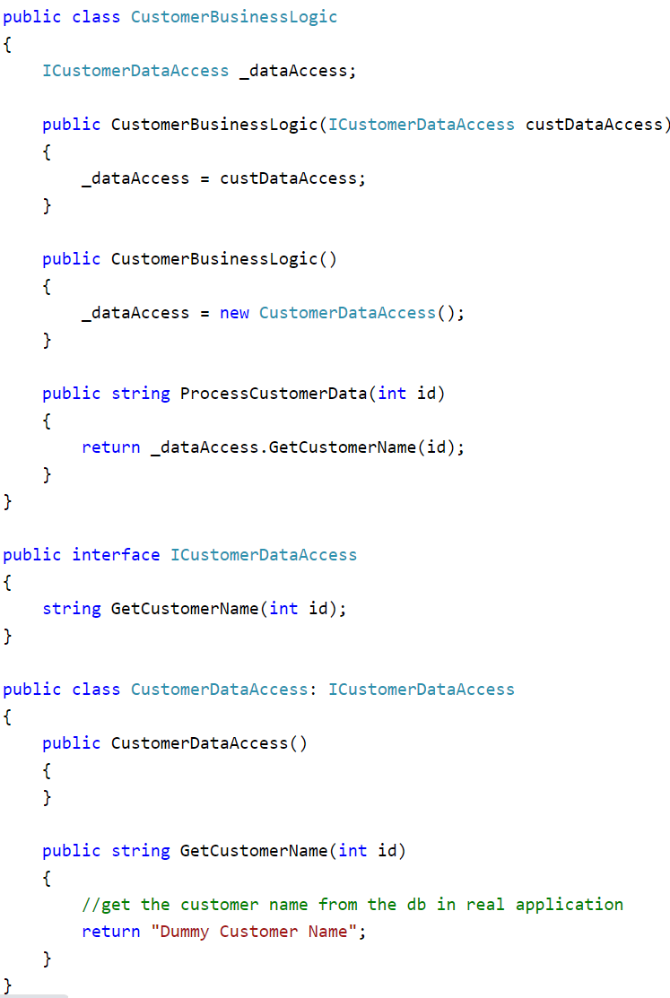
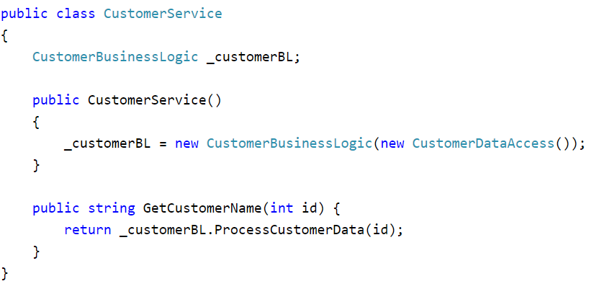
Constructor Injection
When we provide the dependency through the constructor, this is called a constructor injection.
In the example, CustomerBusinessLogic includes the constructor with one parameter of type ICustomerDataAccess. Now, the calling class must inject an object of ICustomerDataAccess.

Slide 31
Constructor Injection
As you can see in the above example, the CustomerService class creates and injects the CustomerDataAccess object into the CustomerBusinessLogic class.
Thus, the CustomerBusinessLogic class doesn't need to create an object of CustomerDataAccess using the new keyword or using factory class.
The calling class (CustomerService) creates and sets the appropriate DataAccess class to the CustomerBusinessLogic class.
In this way, the CustomerBusinessLogic and CustomerDataAccess classes become "more" loosely coupled classes.

Slide 32
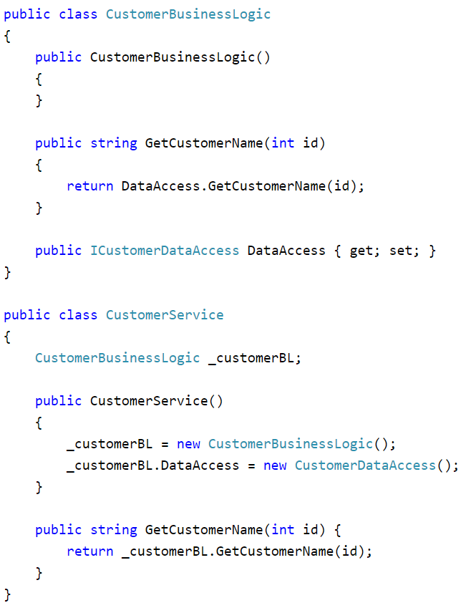
Property Injection
In the property injection, the dependency is provided through a public property.
The CustomerBusinessLogic class includes the public property named DataAccess, where you can set an instance of a class that implements ICustomerDataAccess.
So, CustomerService class creates and sets CustomerDataAccess class using this public property.

Slide 33
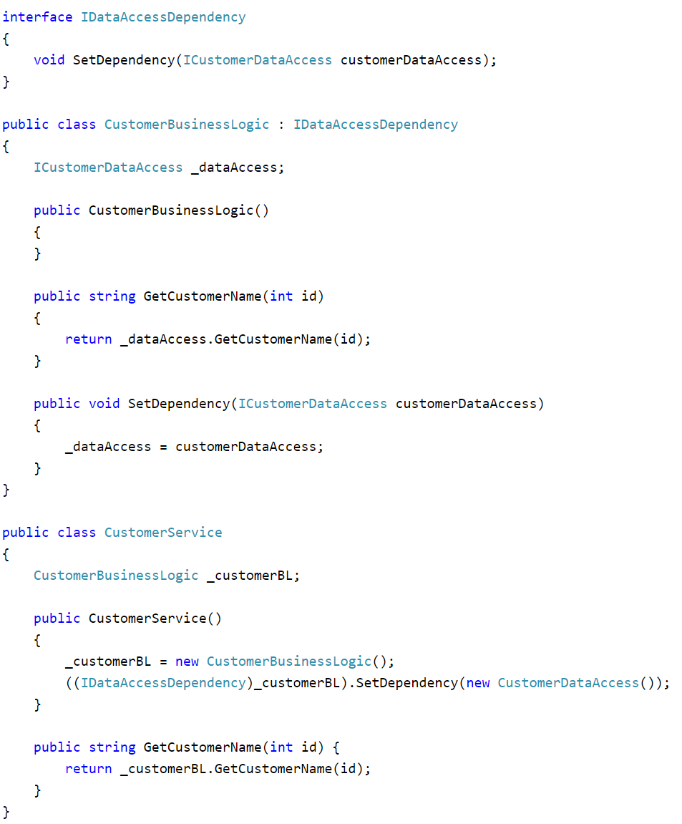
Method Injection
In the method injection, dependencies are provided through methods.
This method can be a class method or an interface method.
The CustomerBusinessLogic class implements the IDataAccessDependency interface, which includes the SetDependency() mehtod. So, the injector class CustomerService will now use this method to inject the dependent class (CustomerDataAccess) to the client class.
Thus, you can use DI and strategy pattern to create loose coupled classes.

Slide 34
IoC Container
So far, we have used several principles and patterns to achieve loosely coupled classes. In professional projects, there are many dependent classes and implementing these patterns is time consuming. Here the IoC Container (aka the DI container) helps us.
IoC Container (a.k.a. DI Container) is a framework for implementing automatic dependency injection. It manages object creation and it's life-time, and also injects dependencies to the class.
The IoC container creates an object of the specified class and also injects all the dependency objects through a constructor, a property or a method at run time and disposes it at the appropriate time. This is done so that we don't have to create and manage objects manually.

Slide 35
IoC Container
All the containers must provide easy support for the following DI lifecycle.
Register: The container must know which dependency to instantiate when it encounters a particular type. This process is called registration. Basically, it must include some way to register type-mapping.
Resolve: When using the IoC container, we don't need to create objects manually. The container does it for us. This is called resolution. The container must include some methods to resolve the specified type; the container creates an object of the specified type, injects the required dependencies if any and returns the object.
Dispose: The container must manage the lifetime of the dependent objects. Most IoC containers include different lifetime managers to manage an object's lifecycle and dispose it.

Slide 36
IoC Containers
There are many open source or commercial containers available for .NET. Some are listed below.
Unity
StructureMap
Castle Windsor
Ninject
Autofac
DryIoc
Simple Injector
Light Inject
More details about IoC: https://www.tutorialsteacher.com/ioc/ioc-container

Slide 37
ASP.NET Core – Project Structure

Slide 38
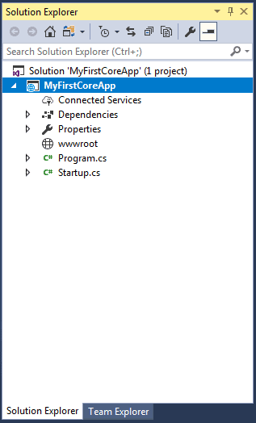
ASP.NET Core - Project Structure
The following is a default project structure when you create an empty ASP.NET Core application in Visual Studio
ASP.NET Core project files and folders are synchronized with physical files and folders. If you add a new file or folder in project folder then it will directly reflect in the solution explorer. You don't need to add it in the project explicitly by right clicking on the project.

Slide 39
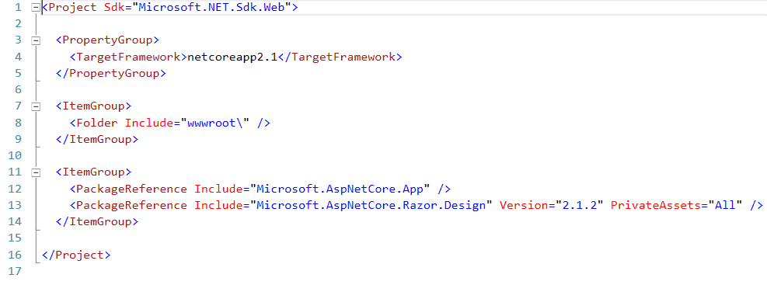
.csproj
The .csproj for the above project looks like below.
The csproj file includes settings related to targeted .NET Frameworks, project folders, NuGet package references etc.

Slide 40
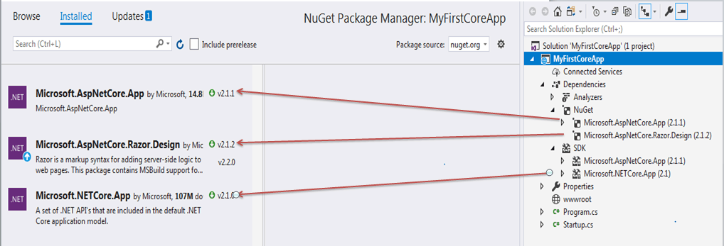
Dependencies
The Dependencies in the ASP.NET Core 2.1 project contain all the installed server-side NuGet packages.
Right click on "Dependencies" and then click "Manage NuGet Packages.." to see the installed NuGet packages

Slide 41
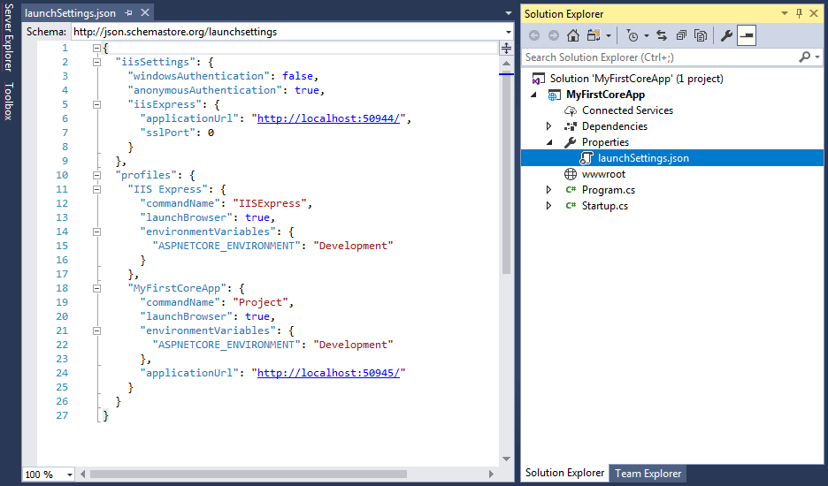
Properties
The Properties node includes launchSettings.json file which includes Visual Studio profiles of debug settings.

Slide 42
ASP.NET Core - wwwroot Folder
By default, the wwwroot folder in the ASP.NET Core project is treated as a web root folder. Static files can be stored in any folder under the web root and accessed with a relative path to that root.
In the standard ASP.NET application, static files can be served from the root folder of an application or any other folder under it. This has been changed in ASP.NET Core. Now, only those files that are in the web root - wwwroot folder can be served over an http request. All other files are blocked and cannot be served by default.

Slide 43
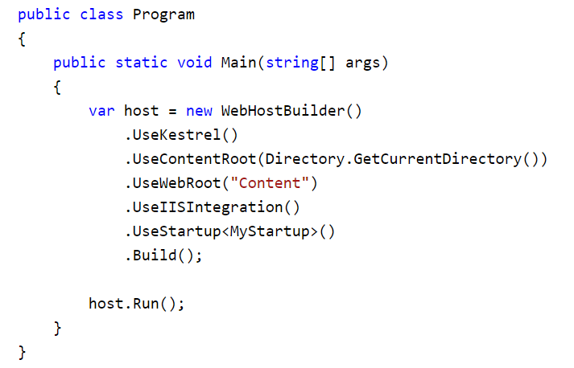
Rename wwwroot Folder
You can rename wwwroot folder to any other name as per your choice and set it as a web root while preparing hosting environment in the program.cs.
For example, let's rename wwwroot folder to Content folder. Now, call UseWebRoot() method to configure Content folder as a web root folder in the Main() method of Program class

Slide 44
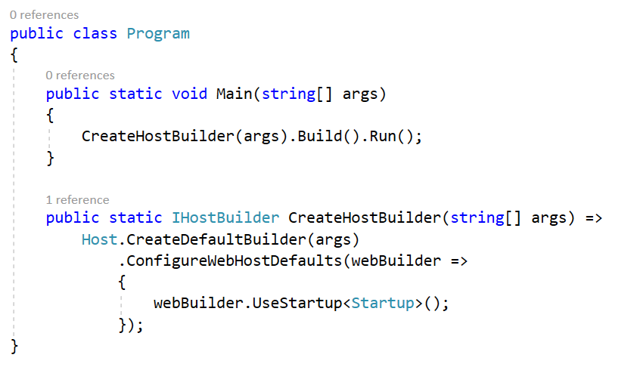
ASP.NET Core - Program.cs
ASP.NET Core web application is actually a console project which starts executing from the entry point public static void Main() in Program class where we can create a host for the web application.
The Main() method calls method expression CreateHostBuilder () to build web host with pre-configured defaults. The CreateHostBuilder expression can also be written as a method that returns IHostBuilder.

Slide 45
ASP.NET Core - Startup Class
ASP.NET Core application must include Startup class. As the name suggests, it is executed first when the application starts.
The startup class can be configured using UseStartup<T>() method at the time of configuring the host in the Main() method of Program class
The name "Startup" is by ASP.NET Core convention. However, we can give any name to the Startup class, just specify it as the generic parameter in the UseStartup<T>() method. For example, to name the Startup class as MyStartup, specify it as .UseStartup<MyStartup>().

Slide 46
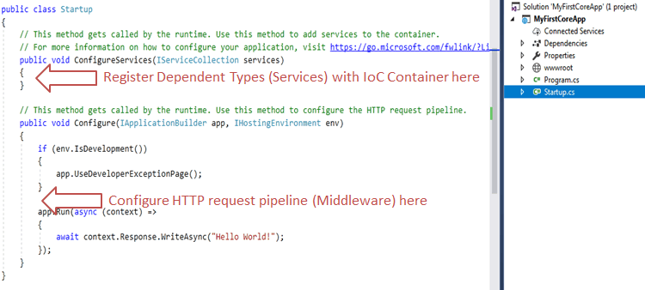
ASP.NET Core - Startup Class
Startup class includes two public methods: ConfigureServices and Configure.
The Startup class must include a Configure method and can optionally include ConfigureService method.

Slide 47
ConfigureServices()
The Dependency Injection pattern is used heavely in ASP.NET Core architecture. It includes built-in IoC container to provide dependent objects using constructors.
The ConfigureServices method is a place where you can register your dependent classes with the built-in IoC container. After registering dependent class, it can be used anywhere in the application. You just need to include it in the parameter of the constructor of a class where you want to use it. The IoC container will inject it automatically.
ASP.NET Core refers dependent class as a Service. So, whenever you read "Service" then understand it as a class which is going to be used in some other class.
ConfigureServices method includes IServiceCollection parameter to register services to the IoC container.

Slide 48
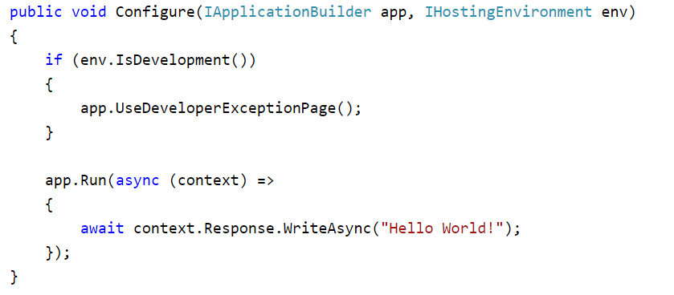
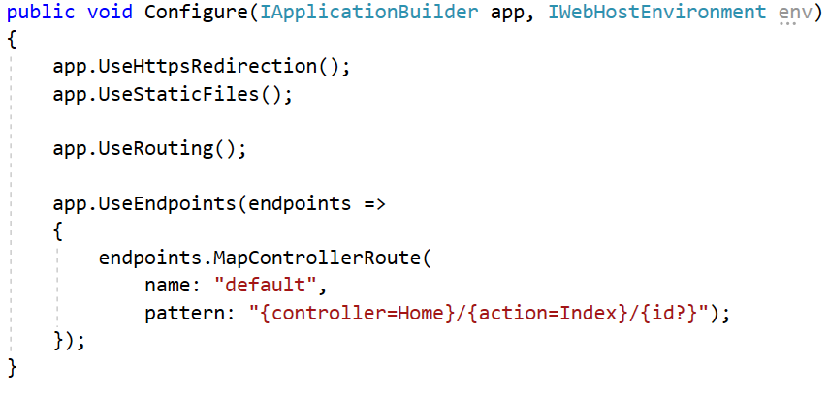
Configure()
The Configure method is a place where you can configure application request pipeline for your application using IApplicationBuilder instance that is provided by the built-in IoC container.
ASP.NET Core introduced the middleware components to define a request pipeline, which will be executed on every request. You include only those middleware components which are required by your application and thus increase the performance of your application.
The following is a default Configure methods.

Slide 49
.NET Core Command-Line Interface
The .NET Core command-line interface (CLI) is a new cross-platform tool for creating, restoring packages, building, running and publishing .NET applications.
We created our first ASP.NET Core application using Visual Studio in the previous chapter. Visual Studio internally uses this CLI to restore, build and publish an application. Other higher level IDEs, editors and tools can use CLI to support .NET Core applications.
More info: https://www.tutorialsteacher.com/core/net-core-command-line-interface

Slide 50
ASP.NET Core - Dependency Injection

Slide 51
ASP.NET Core - Dependency Injection
ASP.NET Core is designed from scratch to support Dependency Injection.
ASP.NET Core injects objects of dependency classes through constructor or method by using built-in IoC container.

Slide 52
Built-in IoC Container
ASP.NET Core framework contains simple out-of-the-box IoC container which does not have as many features as other third party IoC containers. If you want more features such as auto-registration, scanning, interceptors, or decorators then you may replace built-in IoC container with a third party container.
The built-in container is represented by IServiceProvider implementation that supports constructor injection by default. The types (classes) managed by built-in IoC container are called services.
There are basically two types of services in ASP.NET Core:
Framework Services: Services which are a part of ASP.NET Core framework such as IApplicationBuilder, IHostingEnvironment, ILoggerFactory etc.
Application Services: The services (custom types or classes) which you as a programmer create for your application.

Slide 53
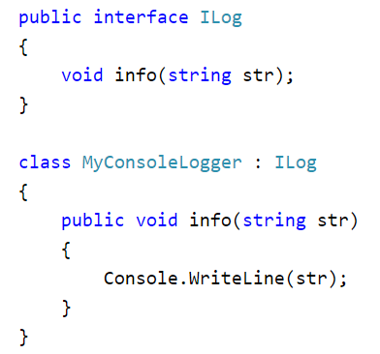
Registering Application Service
Consider the following example of simple ILog interface and its implementation class.
We will see how to register it with built-in IoC container and use it in our application.

Slide 54
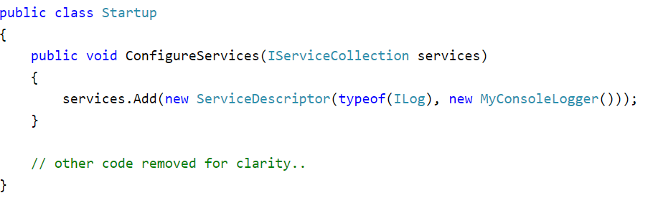
Registering Application Service
ASP.NET Core allows us to register our application services with IoC container, in the ConfigureServices method of the Startup class. The ConfigureServices method includes a parameter of IServiceCollection type which is used to register application services.
Add() method of IServiceCollection instance is used to register a service with an IoC container. The ServiceDescriptor is used to specify a service type and its instance.
We have specified ILog as service type and MyConsoleLogger as its instance.
This will register ILog service as a singleton by default. Now, an IoC container will create a singleton object of MyConsoleLogger class and inject it in the constructor of classes wherever we include ILog as a constructor or method parameter throughout the application.

Slide 55
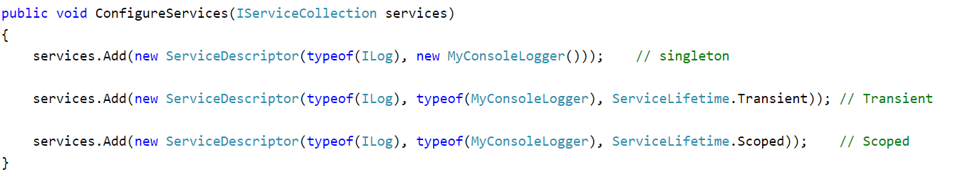
Understanding Service Lifetime
Built-in IoC container manages the lifetime of a registered service type. It automatically disposes a service instance based on the specified lifetime.
The built-in IoC container supports three kinds of lifetimes:
Singleton: IoC container will create and share a single instance of a service throughout the application's lifetime.
Transient: The IoC container will create a new instance of the specified service type every time you ask for it.
Scoped: IoC container will create an instance of the specified service type once per request and will be shared in a single request.

Slide 56
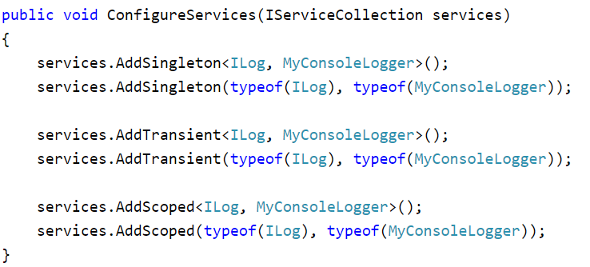
Extension Methods for Registration
ASP.NET Core framework includes extension methods for each types of lifetime; AddSingleton(), AddTransient() and AddScoped() methods for singleton, transient and scoped lifetime respectively.

Slide 57
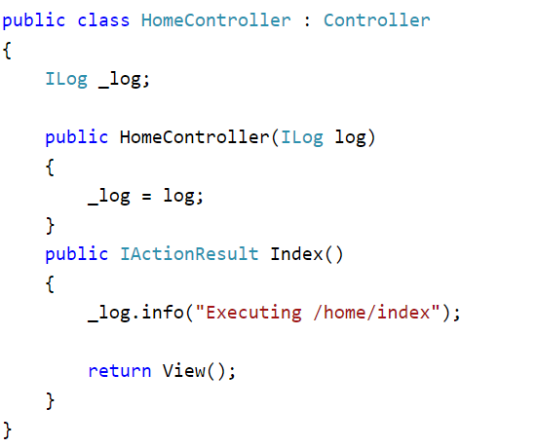
Constructor Injection
Once we register a service, the IoC container automatically performs constructor injection if a service type is included as a parameter in a constructor.
For example, we can use ILog service type in any MVC controller.

Slide 58
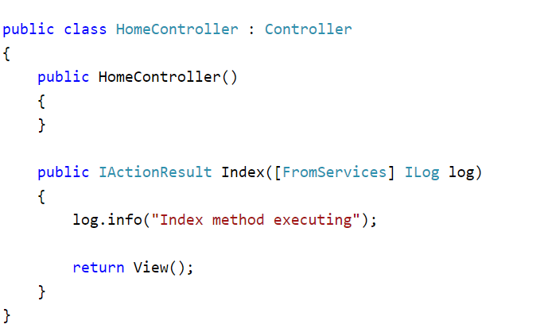
Action Method Injection
Sometimes we may only need dependency service type in a single action method. For this, use [FromServices] attribute with the service type parameter in the method.

Slide 59
ASP.NET Core – Middleware

Slide 60
ASP.NET Core - Middleware
ASP.NET Core introduced a new concept called Middleware.
A middleware is nothing but a component (class) which is executed on every request in ASP.NET Core application.
In the classic ASP.NET, HttpHandlers and HttpModules were part of request pipeline. Middleware is similar to HttpHandlers and HttpModules where both needs to be configured and executed in each request.
Typically, there will be multiple middleware in ASP.NET Core web application. It can be either framework provided middleware, added via NuGet or your own custom middleware. We can set the order of middleware execution in the request pipeline.
Each middleware adds or modifies http request and optionally passes control to the next middleware component. The following figure illustrates the execution of middleware components.

Slide 61
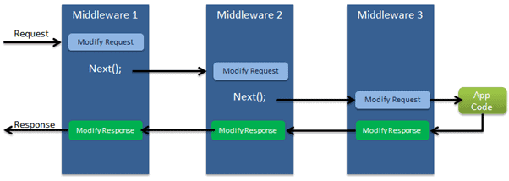
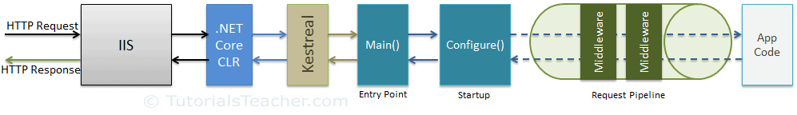
ASP.NET Core - Middleware
https://www.tutorialsteacher.com/core/aspnet-core-middleware

Slide 62
Configure the Default File to be Served on the Root Request
As we learned in the Set Default File section, app.UseDefaultFiles() middleware serves the following files on the root request.
Default.html
Default.htm
Index.html
Index.htm

Slide 63
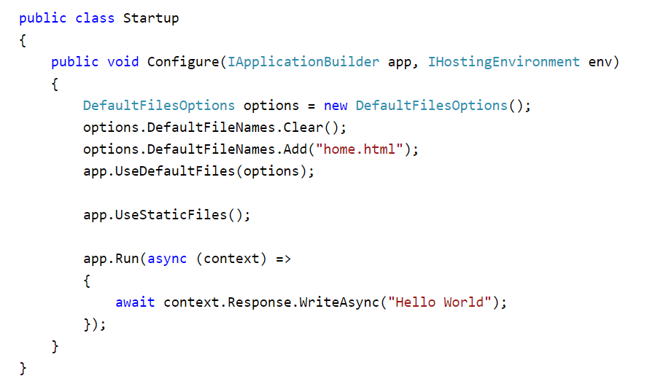
Configure the Default File to be Served on the Root Request
Suppose, you want to set home.html as a default page which should be displayed on the root access. To do that, specify DefaultFilesOptions in the UseDefaultFiles method as shown below.
Now, this will display home.html from wwwroot folder on the root request http://localhost:<port>.
Most middleware's has an ability to be configured using options.

Slide 64
ASP.NET Core - Environment Variable

Slide 65
ASP.NET Core - Environment Variable
Typically, in professional application development, there are multiple phases where an application is tested before publishing it to the real users.
These phases by convention are development, staging, and production.
We as developers might like to control the behavior of an application based on the phases the application is in.
Environment variable indicates the runtime environment in which an application is currently running.
ASP.NET Core uses an environment variable called ASPNETCORE ENVIRONMENT to indicate the runtime environment. The value of this variable can be anything as per your need but typically it can be Development, Staging, or Production. The value is case insensitive in Windows and Mac OS but it is case sensitive on Linux.

Slide 66
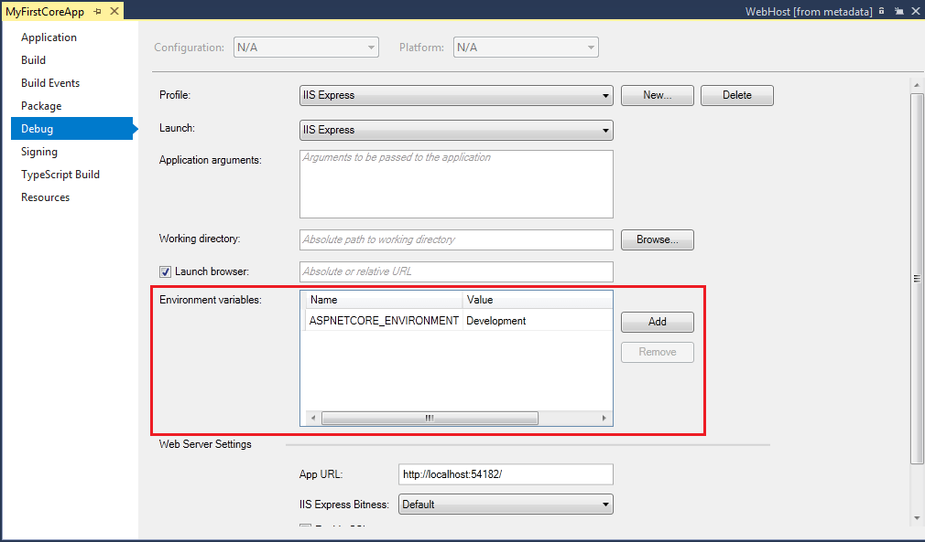
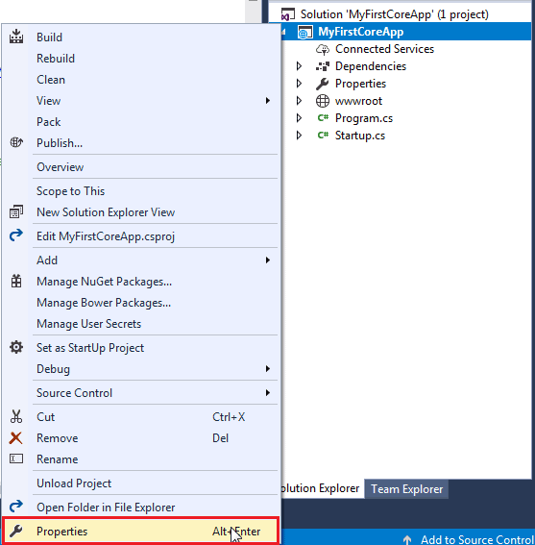
ASP.NET Core - Environment Variable

Slide 67
ASP.NET Core - Exception Handling

Slide 68
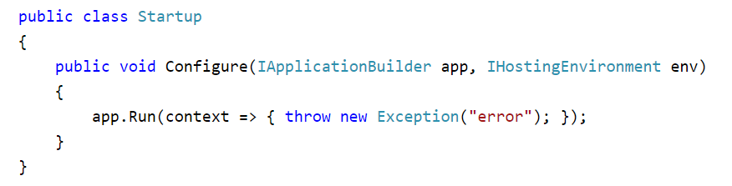
ASP.NET Core - Exception Handling
Exception handling is one of the most important features of any application. Fortunately, ASP.NET Core includes a middleware that makes exception handling easy. In this chapter, we will learn about exception handling in ASP.NET Core application.
By default, ASP.NET Core returns a simple status code for any exception that occurs in an application. Consider the following example of Configure method which throws an error.

Slide 69
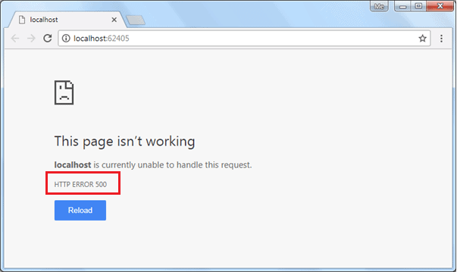
ASP.NET Core - Exception Handling
The above code will display the following result.

Slide 70
Microsoft.AspNetCore.Diagnostics Package
To handle exceptions and display user friendly messages, we need to install Microsoft.AspNetCore.Diagnostics NuGet package and add middleware in the Configure() method. If you are using Visual Studio templates to create ASP.NET Core application then this package might be already installed. If not then you can add Microsoft.AspNetCore.Diagnostics package via NuGet manager.
The Microsoft.AspNetCore.Diagnostics package includes following extension methods to handle exceptions in different scenario:
UseDeveloperExceptionPage
UseExceptionHandler

Slide 71
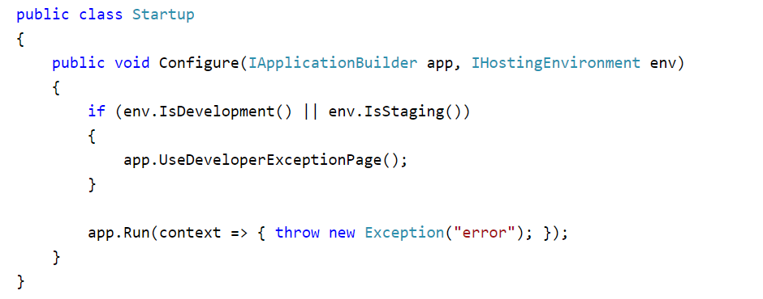
UseDeveloperExceptionPage
The UseDeveloperExceptionPage extension method adds middleware into the request pipeline which displays developer friendly exception detail page. This helps developers in tracing errors that occur during development phase.
As this middleware displays sensitive information, it is advisable to add it only in development environment.

Slide 72
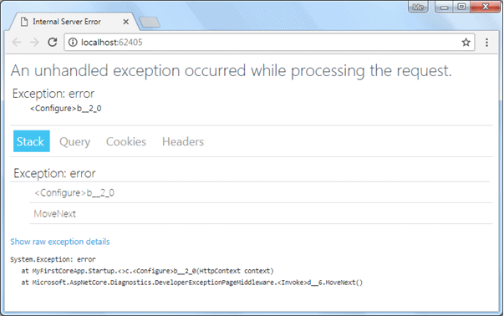
UseDeveloperExceptionPage
The above code will display the following result.
As you can see above, the developer exception page includes 4 tabs: Stack, Query, Cookies, and Headers.
Stack tab displays information of stack trace, which indicates where exactly an error occurred.
Query tab displays information about query string.
Cookies tab displays information about cookies set by the request
Headers tab displays information about headers.

Slide 73
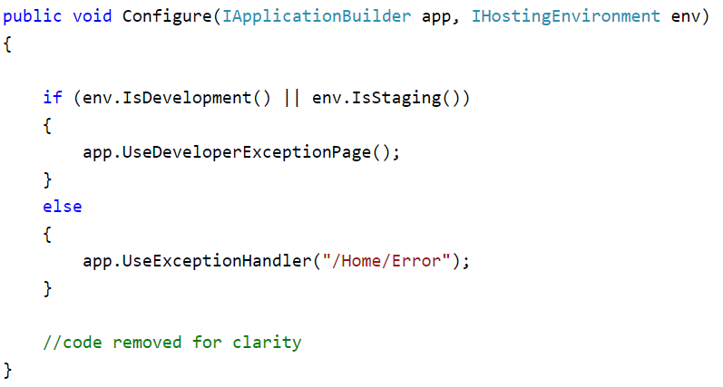
UseExceptionHandler
In MVC Core application, we might want some other controller to handle all exceptions and display custom user friendly error messages. The UseExceptionHandler extension method allows us to configure custom error handling route. This is useful when an application runs under production environment.
Visual Studio automatically creates Error.cshtml under Home folder when you create ASP.NET Core project with MVC template.

Slide 74
ASP.NET Core – Static files

Slide 75
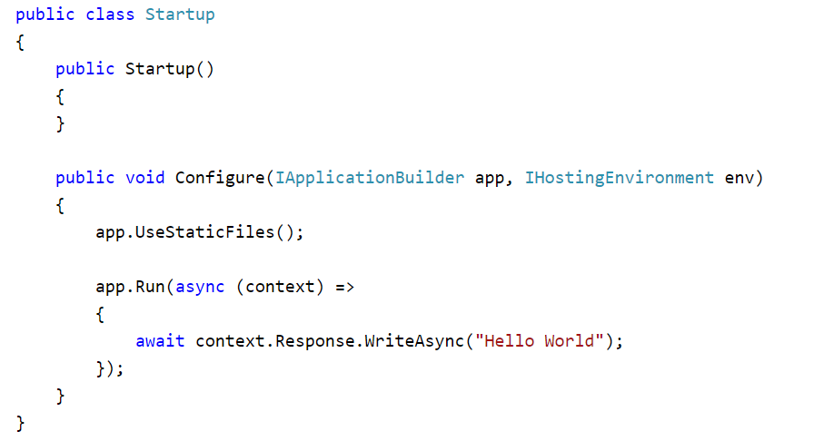
ASP.NET Core - Serving Static Files
The Microsoft.AspNetCore.StaticFiles middleware package is already included in the meta package Microsoft.AspNetCore.All, so we don't need to install it separately in ASP.NET Core 2.x application.
This way we can serve any other file stored in wwwroot folder or sub-folder.

Slide 76
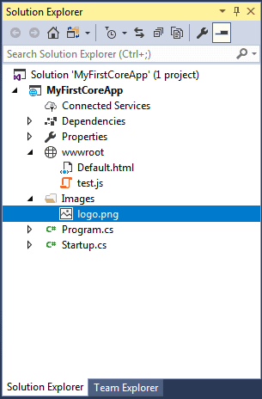
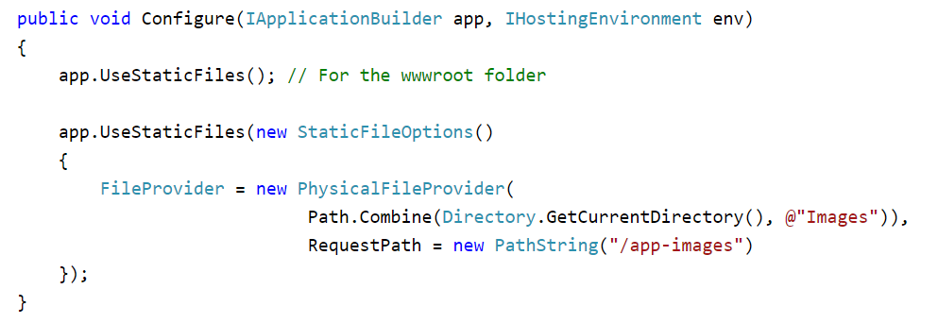
ASP.NET Core - Serving Static Files
Suppose, you want to serve files from the outside of web root folder (wwwroot). For example, you include images in the following Images folder as shown below.
Now, a request to http://localhost/app-images/MyImage.png will
serve the MyImage.png file.

Slide 77
Logging in ASP.NET Core

Slide 78
Fundamentals of Logging in .NET Core
The Logging API is included in the Microsoft.Extensions.Logging package.
The Logging API does not work as standalone. It works with one or more logging providers that store or display logs to a particular medium such as Console, Debug, TraceListeners etc.
So, there are two important building blocks for implementing logging in a .NET Core based application:
Logging API
Logging Providers

Slide 79
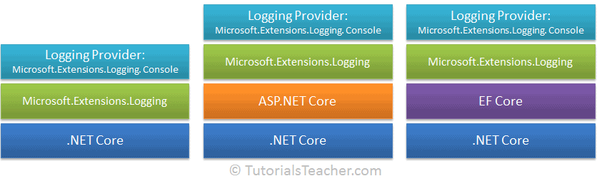
Fundamentals of Logging in .NET Core
The following figure illustrates logging in .NET Core:

Slide 80

Logging API
Microsoft provides logging API as an extension in the wrapper Microsoft.Extensions.Logging which comes as a NuGet package.
Microsoft.Extensions.Logging includes the necessary classes and interfaces for logging. The most important are the ILogger, ILoggerFactory, ILoggerProvider interfaces and the LoggerFactory class.
The following figure shows the relationship between logging classes.

Slide 81
Logging in ASP.NET Core
When you create the ASP.NET Core MVC web application in Visual Studio 2017 (or later), it automatically includes the NuGet package for Microsoft.Extensions.Logging and the following logging providers under the Microsoft.AspNetCore.App NuGet package. So, we don't have to install it manually.
Microsoft.Extensions.Logging.Console
Microsoft.Extensions.Logging.Debug
Microsoft.Extensions.Logging.EventSource
Microsoft.Extensions.Logging.TraceSource

Slide 82

Add Logging Providers
In the ASP.NET Core MVC application, the call to the WebHost.CreateDefaultBuilder(args) method in the Program.cs internally adds the Console, Debug, and EventSource logging providers.
Thus, if you want to use these providers, no need to add them manually. If you want to use other providers or any default provider, then you need to remove all the existing providers and add the provider of your choice. To configure logging providers, call the ConfigureLogging() extension method of IWebHostBuilder.

Slide 83

Store Logs in a Text File
To store logs in a file, install the NuGet package Serilog.Extensions.Logging.File.
Serillog includes an extension method for ILoggerFactory but not for ILogBuilder (in v 1.1.0).
So, go to the Startup.cs file and add the ILoggerFactory parameter in the Configure() method.
Then, call the AddFile() extension method to add Serillog file provider, as shown below.
ASP.NET Core dependency injection will automatically pass an instance of the LoggerFactory for this parameter.
This will store all the logs in the mylog-<date>.txt file, under the Logs folder in your application.

Slide 84

Create Logs in the Controller
We can use ILogger or ILoggerFactory anywhere in an application using ASP.NET Core DI (Dependency Injection). Consider the following example of HomeController:

Slide 85
Create Logs in the Controller
In the above example, the ILogger<HomeController> parameter is included in the constructor. ASP.NET Core DI will pass the ILogger instance, which can be used to log in the Index() and About() action methods.
Passing HomeController as generic type for the ILogger<HomeController>, will be used as a category. For example, specifying ILogger<HomeController< will display a fully qualified name AspDotNetCoreMvcApp.Controllers.HomeController in the logs, as shown below.

Slide 86


Let's understand the above log message.
Here, we logged information using the LogInformation() method, so it starts with "info:" followed by the fully qualified name of the class where a log is created: AspDoteNetCoreMvcApp.Controllers.HomeController[0].
[0] is the event id. You can specify this event id to identify a record, e.g. Id, page number or other important information which uniquely identifies a log.
We didn't specify any event id, so it will be 0.
The next line is an actual log message: "Log message in the Index() method".
The same can be achieved by passing ILoggerFactory in the constructor.

Slide 87
References
https://www.tutorialsteacher.com/core
https://www.tutorialsteacher.com/ioc
https://www.tutorialspoint.com/asp.net_core/index.htm
https://docs.microsoft.com/en-us/aspnet/core/tutorials/first-mvc-app/start-mvc
https://docs.microsoft.com/en-us/aspnet/core/fundamentals/logging

Slide 88
Homework – Custom Logger Service
Create new ASP.NET Core MVC web project using the default template
Create ILoggerService interface and LoggerService with methods allowing log into log file
Log file format should be CSV and to contain the following information
Date
Time
LogLevel (enum - Info, Warning, Error, Critical)
Error message
Inject and implement LoggerService to log exceptions in the controller

